Slide 1

Home
About
Content
Others
NAVIGATOR ASSISTANT
READ MORE

Slide 2



Software Engineering
Home
About
Content
Others
ABOUT
TEAM MEMBERS
Akylova Adinai 12214747
Abdulloh Shabonov 12214754
Kerimaliev Eldar 12230333
Khursanov Nazarbek 12225171

Slide 3
Software Engineering
Home
About
Content
Others
PROJECT OVERVIEW
BRIEF DESCRIPTION
DUAL-INTERFACE
POWERED BY
Route planning, Turn-by-turn directions, Multiple transport modes, Geocoding
Python CLI & Web Application
GraphHopper API

Slide 4

Software Engineering
Home
About
Content
Others
FEATURES INCLUDED
Support for multiple transportation modes (car, bike, foot, etc.)
Turn-by-turn directions and route statistics
Interactive web UI with live input
Robust error handling and rate limit protection
Advanced geocoding for city/state/POI details

Slide 5
Software Engineering
Home
About
Content
Others
Improve usability for general users
Increase flexibility for various navigation needs
Bridge web and CLI user preferences
Enhance educational value and technical scope for team members
WHY THESE FEATURES?

Slide 6


Software Engineering
Home
About
Content
Others
IMPLEMENTATION PROCEDURE
Set up project environment and repository
Integrated GraphHopper API into Python & Node.js backends
Designed modular Python package (RouteCalculator)
Developed a responsive frontend with EJS + CSS + JavaScript
Connected frontend to backend with REST endpoints

Slide 7
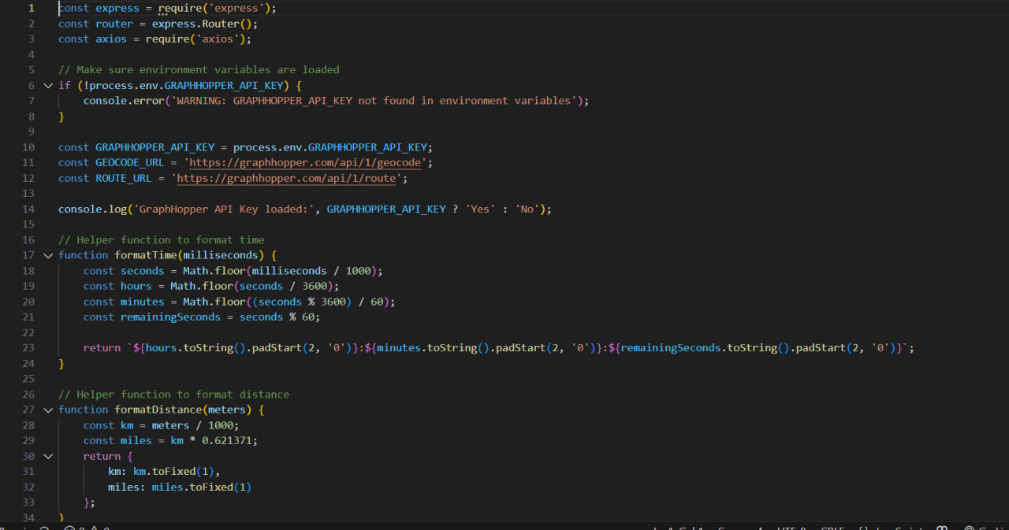
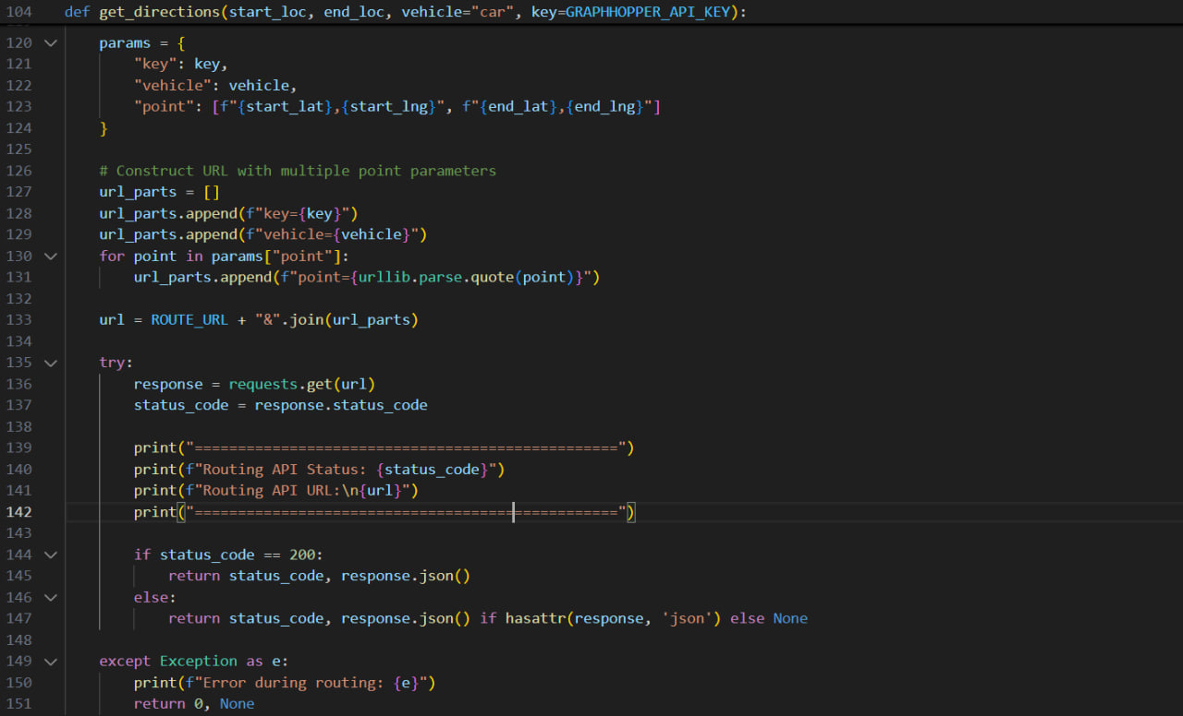
SOftware Engineering
Home
About
Content
Others
CODE SNIPPETS + COMMENTS

Slide 8
Software Engineering
Home
About
Content
Others
TEAM CONTRIBUTIONS
Khursanov Nazarbek | Developer – Python, REST APIs, GitHub, Documentation, PPT
Shabonov Abdulloh | Python, REST APIs, GitHub, Documentation
Kerimeliev ELdar | Developer – Python, REST APIs, GitHub, Documentation, PPT
Akylova Adinai | Developer – Python, REST APIs, GitHub, Documentation, PPT

Slide 9
SOftware Engineering
Home
About
Content
Others
CODE SNIPPETS + COMMENTS

Slide 10

Software Engineering
Home
About
Content
Others
REFLECTIONS & CHALLENGES
Issues faced:
API rate limits;
Cross-origin request issues on web;
Team coordination on GitHub merges;
Solutions:
Implemented error handling and logging;
Used .env configuration for flexible debugging;
Weekly sync-ups & pull request code reviews;
Learnings:
Working in a full-stack project;
Handling REST APIs from both frontend and backend;
Writing clean, collaborative code;

Slide 11
Software Engineering
Home
About
Content
Others
GITHUB WORKFLOW
Branching for features (feature/web-ui, cli-routing)
Team members worked in parallel branches
Used Pull Requests, Code Reviews, and Merging
GitHub Issues used for task tracking

Slide 12
Software Engineering
Home
About
Content
Others
FUTURE ENHANCEMENTS (BACKLOG)
Add real-time traffic data
Support multi-stop routing
Local language translation support
Export directions as PDF or JSON
Mobile application (React Native or Flutter)

Slide 13

GITHUB LINK

